Slide 1


RECYLING OF DISMANTLED CONCRETE USING IN THE FIELD OF CONSTRUCTION

Slide 2

ABSTRACT
This project mainly discus about the concrete production by mixing recycle aggregate to get the required strength for different applications by replacing the natural coarse aggregate. The Concrete which is made by replacing the recycled coarse aggregate strength can be determined by few physical The collected recycle aggregate is used to make a concrete such that, several concrete specimen are prepared and evaluated with the virgin concrete. This project likewise talk about the examination of reuse aggregate with constant concrete blend of M20 and water cement proportion, similar to two unique ages have been taken and the age difference between those ages are of 30 years and few samples were caste and this two types of reuse aggregate is compared with conventional cement. mechanical characteristics.

Slide 3

INTRODUCTION
As we everyone knows that concrete is the main construction material across the world wide. As 2/3rd of the concrete consists of aggregates, the skeleton form of the concrete is formed by the presence of aggregates only
To manage the concrete waste the usage of recycle coarse aggregate is very important step towards the development and reservation of the environmental.
The property of the recycled aggregate is the main problem for using it because they will not fill the desire requirement as to alternatively replace with that of naturally coarse aggregate. This property of recycled coarse aggregate are mainly depends on the recycle material quality.

Slide 4
SOURCE OF RECYCLE AGGREGATE
The main source of recycled coarse aggregate are from the concrete structures which have exhausted there limit of serviceability, that may be either from the old houses, roads, industrial building, old hospitals, theaters, government building, when the structure is attracted to heavy fire accident’s, earth quakes, land sliding’s etc.
Finding the aggregate of different ages is a very typical task, this project mainly focus on the collection of two unique ages of recycled aggregate, so two ages of aggregates have been collect and named it as AGE 2 and AGE 2

Slide 5
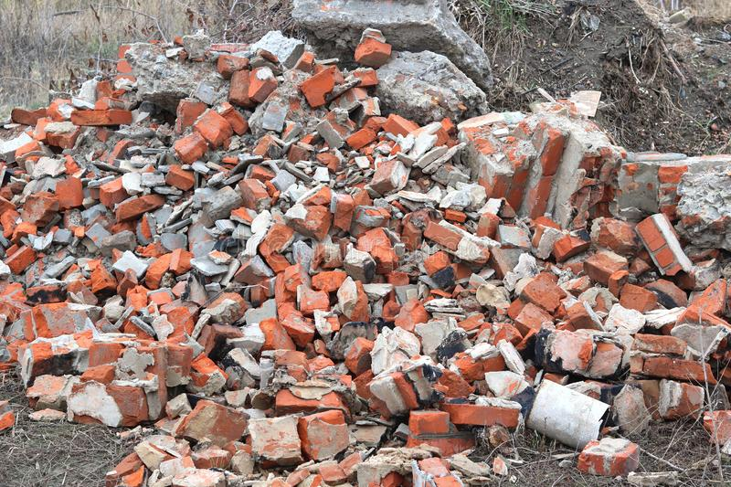
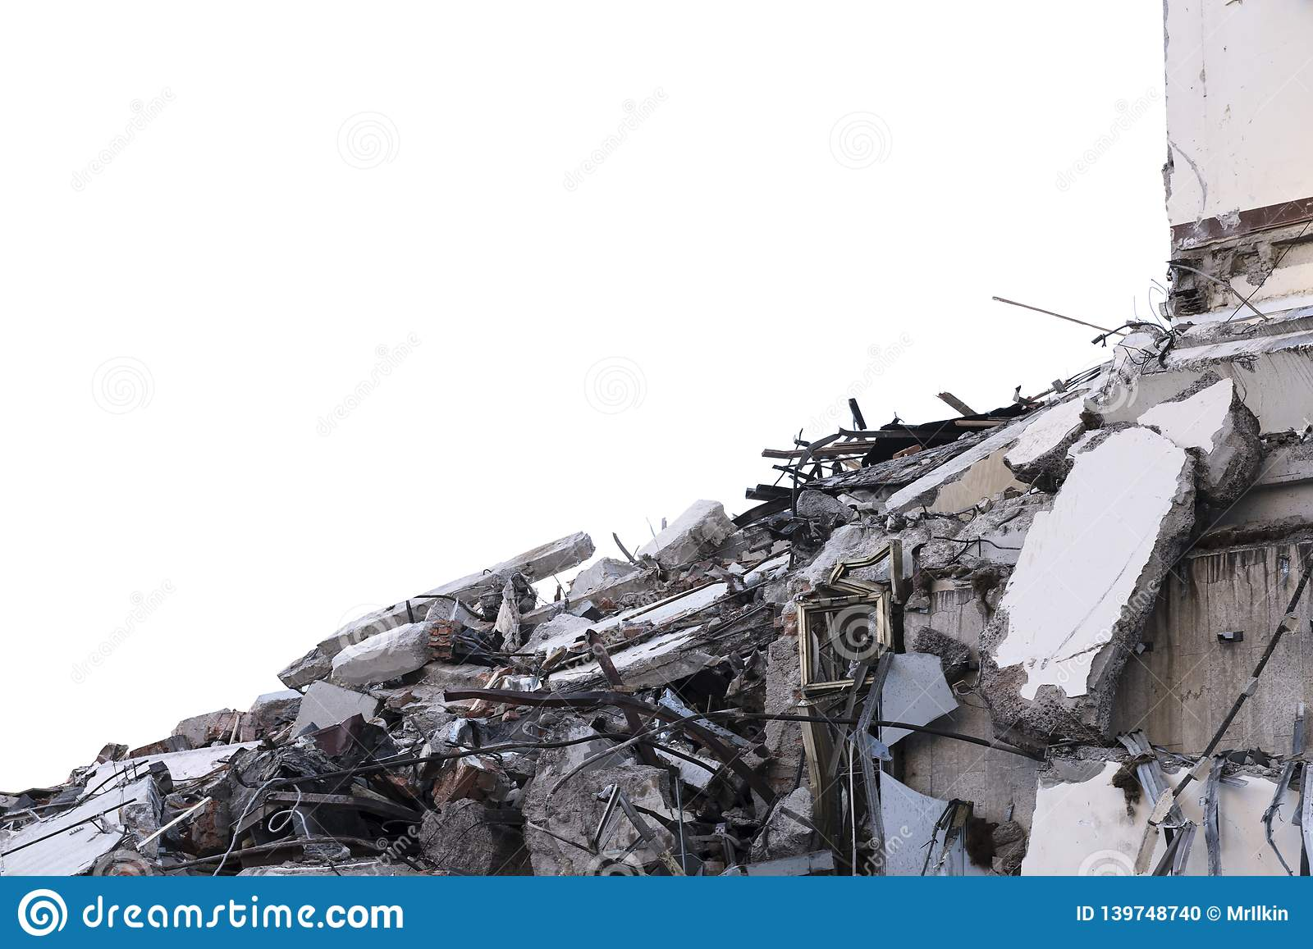
Pictures of Demolitiod and from where aggregates are collected

Slide 6

CEMENT
It is the one of the important binding material used for preparing the concrete. It is made by mixing calcareous (lime) and argillaceous (clay) material in 2/3rd and 1/3rd proportion respectively. When water is added with cement a reaction(chemical) takes place, the nature of that reaction is an exothermic, a certain amount of heat is produced is known as heat of hydration. The better Portland cement exist in the following chemical proportions and ingredients like Alumina (6%), Silica (20%), Lime (63%, Iron oxide (3%), Magnesium oxide(2%). From the above chemical ingredient like Iron oxide, Alumina, Silica are called as Acidic materials whereas Magnesium and Lime are called as Alkaline materials a cert PPC 53 grade of cement has been used for this experiments this ordinary Portland cement of 53 grade has been conformed to IS 1226:1987.

Slide 7
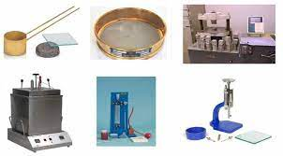
Tests on Cements
Fineness Test.
Consistency Test.
Setting Time Test.
Strength Test.
Soundness Test.
Heat of Hydration Test.
Tensile Strength Test.
Chemical Composition Test.

Slide 8
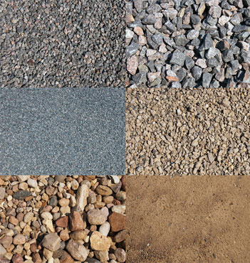
AGGREGATES
FINE AGGREGATE:-
The sand which is available locally used for this project, and it is of wet aggregate, so for getting desire mix the dry sand quantity has been multiples by 1.35 time. Fine aggregate of size usually less than 4.75 mm
COARSE AGGREGATE:-
The aggregate of size 12 mm is used for this experiment on the basis of size of the cube and the prism. Coarse aggregate of usually more than 4.75 mm
Natural Coarse Aggregate(NCA)
Recycled Coarse Aggregate(RCA)
Age 1 Recycle Coarse Aggregate
Age 2 Recycle Coarse Aggregate

Slide 9
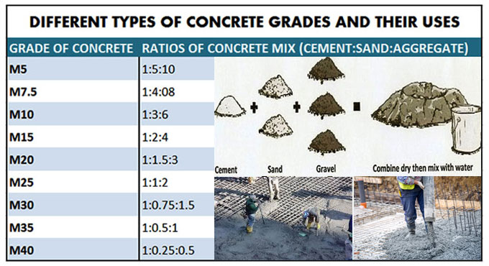
Grades of Concrete
Grades of Concrete
M5 | 1 : 5 : 10 | 5 MPa | 725 psi
M7.5 | 1 : 4 : 8 | 7.5 MPa | 1087 psi
M10 | 1 : 3 : 6 | 10 MPa | 1450 psi
M15 | 1 : 2 : 4 | 15 MPa | 2175 psi
M20 | 1 : 1.5 : 3 | 20 MPa | 2900 psi
Standard Grade of Concrete
M25 | 1 : 1 : 2 | 25 MPa | 3625 psi
M30 | Design Mix | 30 MPa | 4350 psi
M35 | Design Mix | 35 MPa | 5075 psi
M40 | Design Mix | 40 MPa | 5800 psi
M45 | Design Mix | 45 MPa | 6525 psi
High Strength Concrete Grades
M50 | Design Mix | 50 MPa | 7250 psi
M55 | Design Mix | 55 MPa | 7975 psi
M60 | Design Mix | 60 MPa | 8700 psi
M65 | Design Mix | 65 MPa | 9425 psi
M70 | Design Mix | 70 MPa | 10150 psi

Slide 10
CONCRETE MIX
Cement | Fine aggregate(F.A) | Coarse aggregate(C.A) | Water-Content | Water to cement Ratio
420 kg/m³ | 630 kg/m³ | 1260kg/m³ | 210 kg/m³ | 0.5
The nominal mix of M20 has been used for the concrete mi
Concrete mix cases:-
The concrete is mixed in such ways that there is only change in the replacement of virgin coarse aggregate with reuse coarse aggregate, the replacement is of 30 percentage, 60 percentage and 100 percentage to find the strength comparison of the recycled coarse aggregate

Slide 11
QUANTITY OF MATERIAL REQUIRED FOR ONE CONCRETE CUBE
Mix Design | Cement | Sand | Aggregate | Sum of Mix
M-20 | 1 | 1.5 | 3 | 5.5
 | R.C.A (KG) | NO. OF CUBES | TOTAL R.C.A (KG) | NO. OF AGE SAMPLES | WEIGHT OF R.C.A REQUIRED
30% | 0.38304 | 3 | 1.14912 | 2 | 2.29824
60% | 0.76608 | 3 | 2.29824 | 2 | 4.59648
100% | 1.2768 | 3 | 3.8304 | 2 | 7.6608

Slide 12
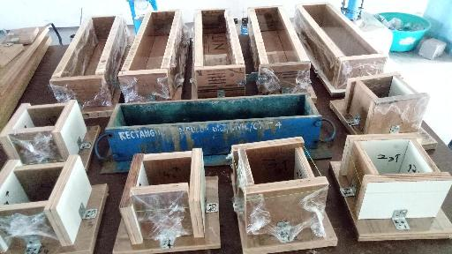
Preparation of Mould
There are total 9 moulds for cubes of 100X100X100 mm were made and 8 prisms of 100X100X500 mm are made for casting the concrete mix
Casting and curing of specimen
Totally 21 cubes and 21 prisms were moulded and tested at 28 days, out of which 9 cubes and 9 prisms are casted with one age of reused aggregate with various substitution of natural coarse aggregate like 30 percentage,, 60 percentage, and 100 percentage.

Slide 13
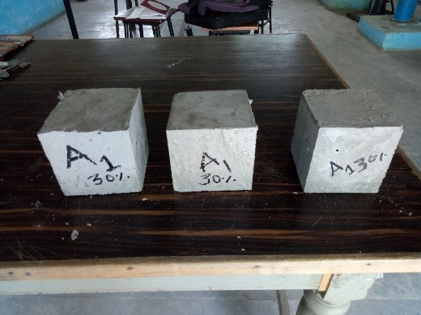
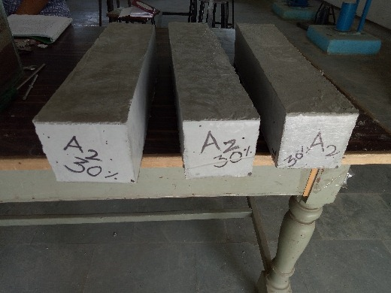
3 cubes casted with AGE 1 &2 recycled coarse aggregate (R.C.A) with 30% substitution of natural coarse aggregate (N.C.A)
AGE 1
AGE 2

Slide 14
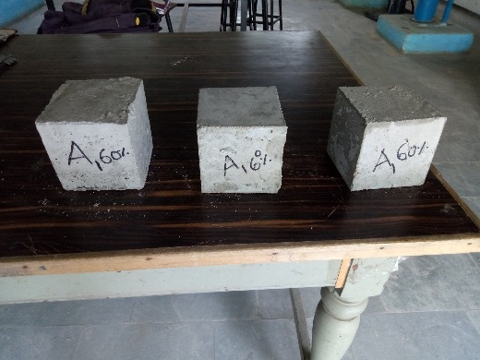
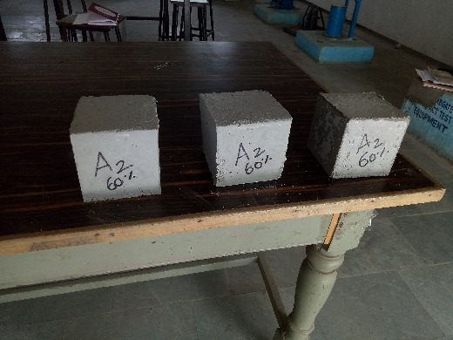
3 cubes casted with AGE 1 &2 recycled coarse aggregate (R.C.A) with 60% substitution of natural coarse aggregate (N.C.A)
AGE 1
AGE 2

Slide 15
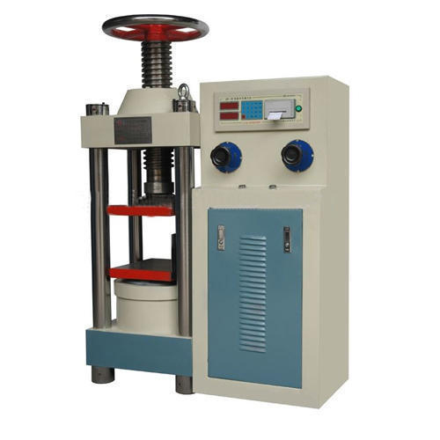
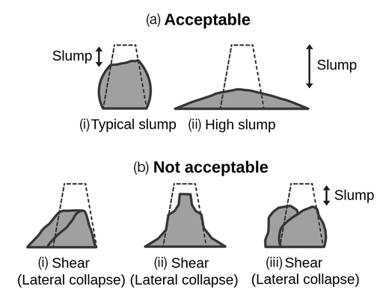
Tests conducted on fresh concrete
Flexural strength
Compressive strength on cubes
Slump cone Test

Slide 16

CONCLUSION
The compressive strengths of demolished concrete aggregate (R.C.A) 12.24, 13.43, 14.56 and 15.87 Mpa for
7, 14, 21 and 28 days respectively which was unacceptable for concrete structure construction works for that it revealed fewer results than the standard. The compressive strengths of natural aggregate (R.C.A) 23.53, 28.32, 28.02
and 36.91 Mpa for 7, 14, 21 and 28 days respectively which was acceptable for concrete structure construction works for that it revealed greater results than the standard. As the percentage of recycled coarse aggregate was increased the compressive strength and the slump of the concrete decreased correspondingly. As observed from the slump test result, addition of more than 50% of recycled coarse aggregate increases the absorption capacity which reduces the compressive strength of the concrete. Blending recycle coarse aggregate with natural aggregate up to 75% in concrete does not affect the compressive strength of the concrete.

Slide 17
THANKING YOU
A PPT BY
SAI CHANDRA SHEKAR
SAI KIRAN
NARESH
SAI PAVAN
SHUBHAM YADAV

